Slide 1
Pitch Deck Template
Make a copy of this deck.
Do NOT add or remove any slides
Don’t forget to click on ‘Share’ and set ‘General Access’ to anyone with the link can view

Slide 2

Quantum Financial Firewall
Stopping Frauds Before It Even Begins
Team Name : ProbSolver

Slide 3
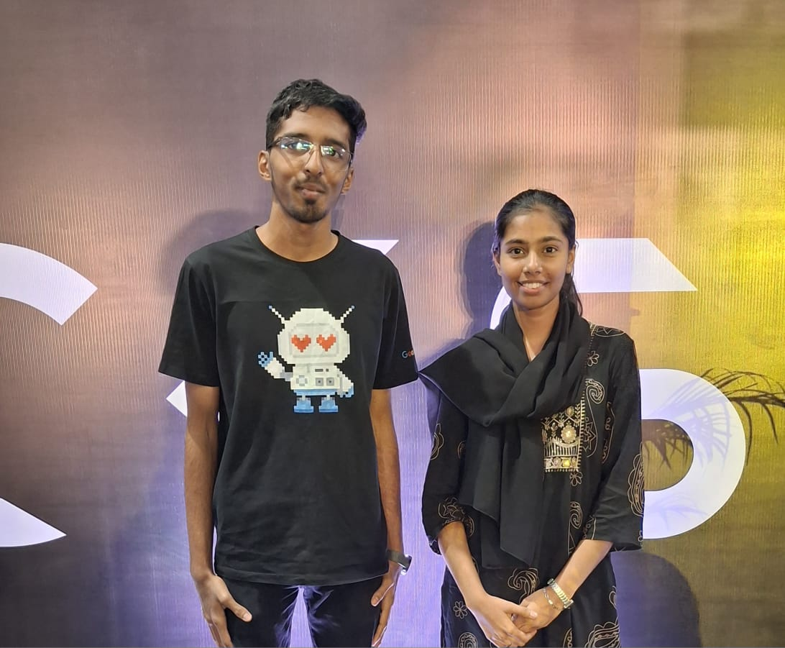
A picture of your team!
Aatif Shaikh | Ariba Khan | - | -

Slide 4
Problem Statement
Current financial systems cannot protect users from real-time fraud, multi-rail threats, and upcoming quantum attacks, QFF solves this by providing the world’s first universal, AI-driven, quantum-secure transaction firewall.

Slide 5
Solution
A single universal protection layer that secures every kind of transaction — UPI, bank transfers, cards, wallets, crypto, forex, trading — something no existing system unifies today.
An Agentic AI engine that evaluates risk before money leaves the user’s device, detecting scams, abnormal behavior, suspicious receivers, velocity spikes, and fraud signatures in real time.
Quantum-secure communication using PQC algorithms and simulated QKD, ensuring transactions stay protected even against future quantum computers that can break today’s encryption.
A live risk score with explainability, giving users clear visibility into why a transaction is safe, flagged, or blocked — something traditional banking apps don’t offer.
Tamper-proof, immutable transaction logs, enabling complete transparency, auditability, and trust for users, banks, and regulators.
Independent security layer that continues to protect users even if a bank merges, shuts down, or faces internal fraud — ensuring consistent safety across institutions.
A system designed not just to react, but to predict and prevent fraud, making financial security proactive instead of defensive.

Slide 6
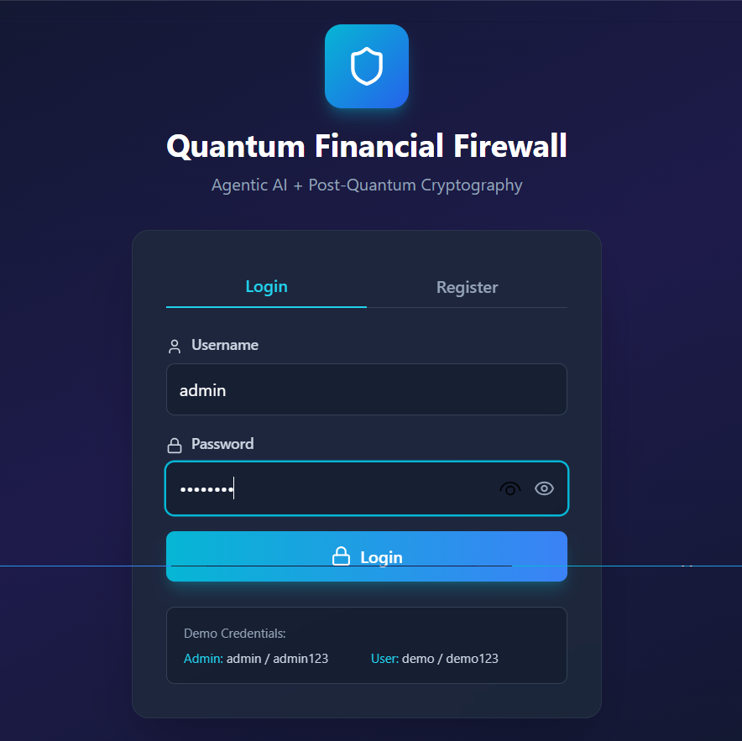
Screenshot 1

Slide 7
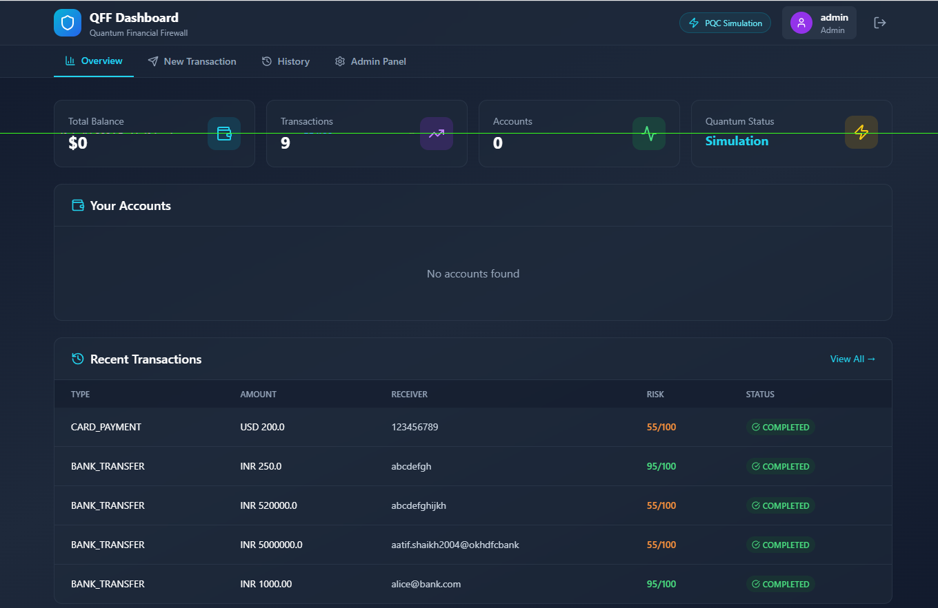
Screenshot 2

Slide 8
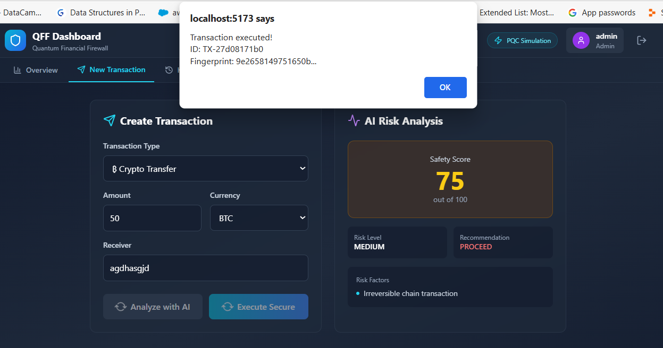
Screenshot 3

Slide 9
Business Model
B2B Licensing to Banks & Fintechs : primary revenue through per-user or per-transaction security engine licensing.
Premium User Subscriptions : QFF Shield for advanced fraud alerts, AI risk reports, and quantum-safe protection.
Enterprise Dashboards : real-time fraud intelligence, anomaly heatmaps, and risk analytics for institutions.
Government & Regulator Contracts : RBI-style agencies buy national-level fraud intelligence, behavioral risk clusters, and quantum readiness audits.
Incentive-Based Revenue : banks pay a share of the money QFF saves by detecting and blocking fraud before execution.
Fraud Intelligence Marketplace (Cluster-Based) : selling scam clusters, behavioral risk graphs, and fraud-network intelligence to banks and regulators.
Internal Security Plugins for Fin Apps : fintechs integrate QFF’s agentic risk engine to secure payments, wallets, and trading flows.
Micro-Revenue from Fraud Prevention APIs : per-call fees for identity risk scoring, receiver verification, and anomaly checks.

Slide 10
Anything else?
World First Prototype that combines Agentic AI with Quantum Secure Financial Protection across all payment rails.
QFF is not just a fintech product , it is a universal security layer built to protect every payment rail.
Our Agentic AI performs real-time, pre-transaction fraud detection, analyzing behavior, anomalies, receiver safety, and risk patterns before money leaves the account.
Quantum-safe protection is built in from day one, preparing banks and fintechs for upcoming PQC and QKD requirements that most institutions are not ready for.
The solution works independently of banks, ensuring users remain protected even if banks merge, fail, face outages, or experience internal fraud weaknesses.
The system supports irregular income users, giving personalized spending insights, risk alerts, and financial coaching that traditional banking apps fail to offer.
QFF transforms financial security from reactive to proactive, from fragmented to unified, and from vulnerable to quantum-safe, building the future of trusted digital money for India and the world.

Slide 11
Thank you
Announcement : Mumbai hacks 25, securing Guinness Record
Lessss Goooo !!

